Slide 1
Rush Hour
ProgrAmsterdam
Kevin Vuong
Michael Berend
Jelle Roebroek

Slide 2
1.
Inleiding opdracht
Let’s start with the game

Slide 3
Inleiding Opdracht
Schrijf een computer programma dat zorgt dat de rode auto in zo min mogelijk stappen naar buiten kan.

Slide 4
Rush Hour
Rode auto geblokkeerd door andere auto’s
In zo min mogelijk stappen naar buiten
7 grids

Slide 5
2.
Borden en State Spaces

Slide 6
State space
Hoe berekend?

Slide 7
State spaces
Game 1 Upperbound: 1.000.000 spaces
Game 2
Upperbound: 13.500.000 spaces
Game 3 Upperbound: 2.025.000 spaces

Slide 8
State spaces
Game 4 Upperbound: 6.776 • 10⁹ spaces
Game 5
Upperbound: 1.26467•10¹⁴ spaces
Game 6 Upperbound: 5.16408•10¹⁴ spaces

Slide 9
State Spaces
Game 7 Upperbound: 1.197•10²⁷ spaces

Slide 10
2.
Algoritmes

Slide 11
Algoritmes
Random
Breadth First Search
Depth First Search
Beam search
A-Star

Slide 12
Random Algoritme
Waarom
Alvast een indicatie van oplossing

Slide 13
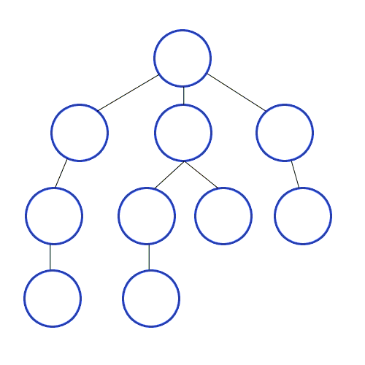
Breadth First Search
Waarom
Altijd kortste pad
Nadelen
Veel geheugen

Slide 14
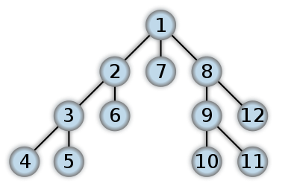
Depth First Search
Waarom
Kost minder geheugen
Nadelen
Niet altijd kortste pad
Maximale diepte nodig
States meerdere keren bezocht

Slide 15
Beam Search
Waarom
Minder geheugen
Nadelen
Pruning nodig
Heuristiek nodig
Een eindoplossing nodig
Heuristiek
X_{i}: veranderbare positie van auto i op bekeken configuratie
Y_{i}: veranderbare positie van auto i op eind configuratie
Score = ∑_{i} | X_{i} – Y_{i} |

Slide 16
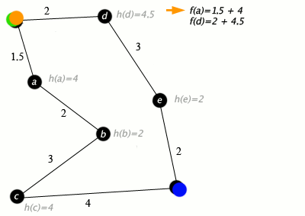
A-Star Algoritme
Waarom
Altijd korste pad
Nadelen
Eind bord nodig
Heuristiek nodig, die moet
onderschatten
Heuristiek
X_{i}: veranderbare positie van auto i op bekeken configuratie
Y_{i}: veranderbare positie van auto i op eind configuratie
Score = ∑_{i} 1_{| Xi – Yi | > 0}

Slide 17
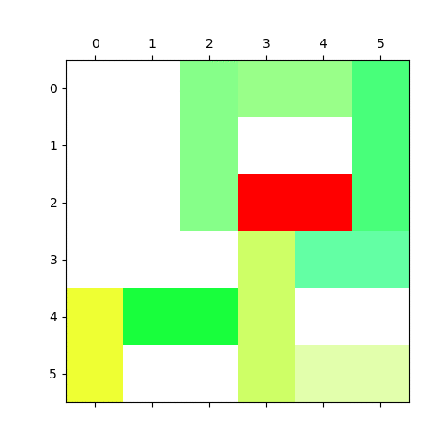
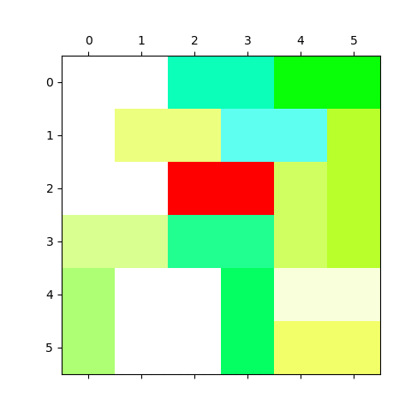
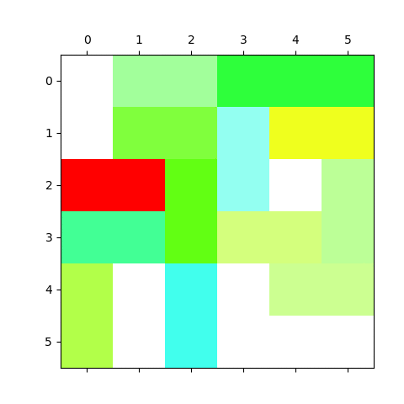
Beste oplossingen
Game 1
33 zetten
Game 2
15 zetten
Game 3
21 zetten
Alle algoritmes
Alle algoritmes
Alle algoritmes

Slide 18
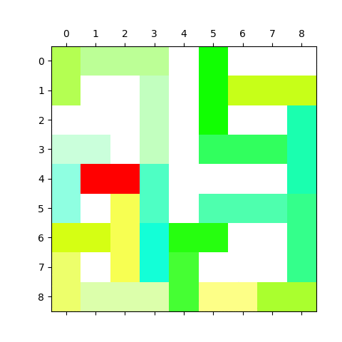
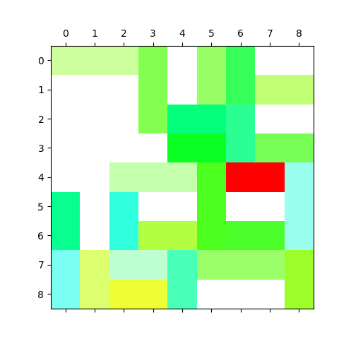
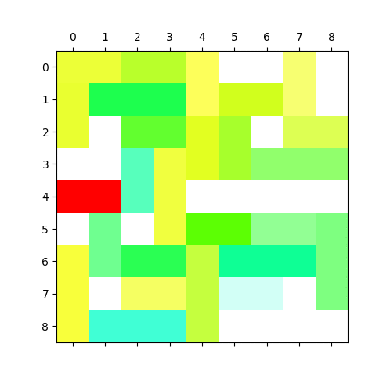
Beste oplossingen
Game 4
27 zetten
Game 5
23 zetten
ssdfsdf
Game 6
18 zetten
Alle algoritmes
A Star, Beam Search
A Star, Beam Search

Slide 19
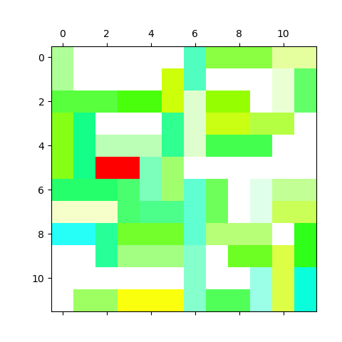
Beste oplossingen
Game 7
25 zetten
A Star, Beam Search

Slide 20
4.
Experimenteren

Slide 21
Experiment
xxx

Slide 22
6.
Conclusie & vervolg onderzoek

Slide 23
Conclusie
Voorkeur altijd naar klassieke BF search
Bij borden waar brute forcen niet mogelijk is, A-star gebruiken
Voorkeur gaat uit naar A-Star ipv Beam Search

Slide 24
Vervolg onderzoek
Meer heuristieken
Daarmee meer experimenteren

Slide 25
Hartelijk dank!
Vragen?
Kevin Vuong
Michael Berend
Jelle Roebroek

Slide 26
1.
TRANSITION HEADLINE
Let’s start with the first set of slides

Slide 27
Infra & Data structuur
I am Jayden Smith
I am here because I love to give presentations.
You can find me at @username

Slide 28
Quotations are commonly printed as a means of inspiration and to invoke philosophical thoughts from the reader.

Slide 29
BIG CONCEPT
Bring the attention of your audience over a key concept using icons or illustrations

Slide 30
YOU CAN ALSO SPLIT YOUR CONTENT
White
Is the color of milk and fresh snow, the color produced by the combination of all the colors of the visible spectrum.
Black
Is the color of coal, ebony, and of outer space. It is the darkest color, the result of the absence of or complete absorption of light.

Slide 31
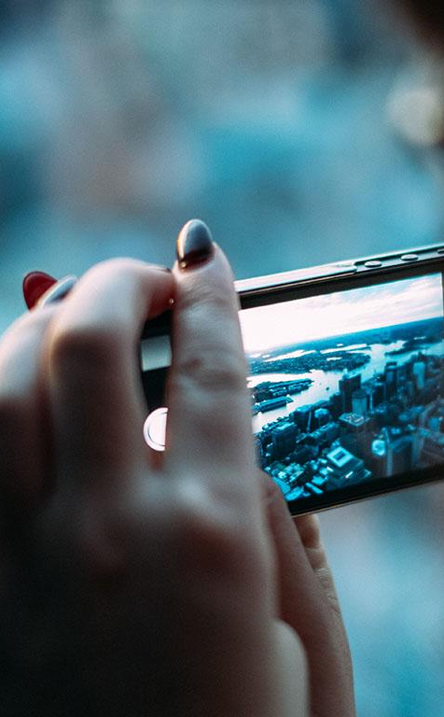
A PICTURE IS WORTH A THOUSAND WORDS
A complex idea can be conveyed with just a single still image, namely making it possible to absorb large amounts of data quickly.

Slide 32
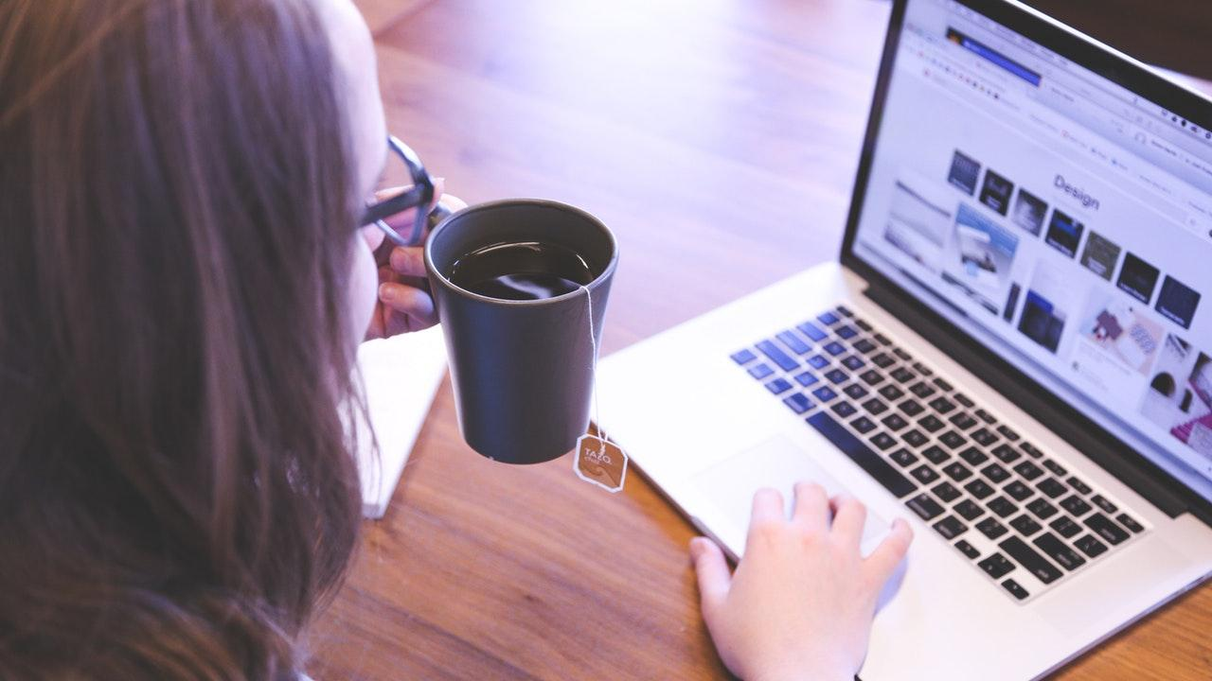
Want big impact?
Use big image.

Slide 33
USE CHARTS TO EXPLAIN YOUR IDEAS
White
Gray
Black

Slide 34
AND TABLES TO COMPARE DATA
 | A | B | C
Yellow | 10 | 20 | 7
Blue | 30 | 15 | 10
Orange | 5 | 24 | 16

Slide 35
MAPS
our office

Slide 36
89,526,124
Whoa! That’s a big number, aren’t you proud?

Slide 37
89,526,124$
185,244 users
100%
That’s a lot of money
And a lot of users
Total success!

Slide 38
OUR PROCESS IS EASY
first
second
last

Slide 39
LET’S REVIEW SOME CONCEPTS
Yellow
Is the color of gold, butter and ripe lemons. In the spectrum of visible light, yellow is found between green and orange.
Blue
Is the colour of the clear sky and the deep sea. It is located between violet and green on the optical spectrum.
Red
Is the color of blood, and because of this it has historically been associated with sacrifice, danger and courage.
Yellow
Is the color of gold, butter and ripe lemons. In the spectrum of visible light, yellow is found between green and orange.
Blue
Is the colour of the clear sky and the deep sea. It is located between violet and green on the optical spectrum.
Red
Is the color of blood, and because of this it has historically been associated with sacrifice, danger and courage.

Slide 40
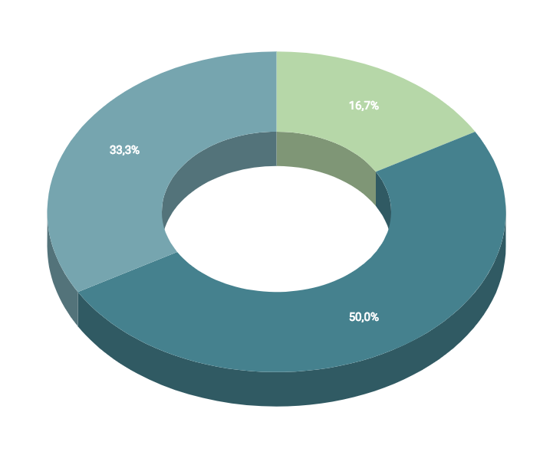
You can insert graphs from Google Sheets

Slide 41
ANDROID PROJECT
Show and explain your web, app or software projects using these gadget templates.
Place your screenshot here

Slide 42
iPHONE PROJECT
Show and explain your web, app or software projects using these gadget templates.
Place your screenshot here

Slide 43
TABLET PROJECT
Show and explain your web, app or software projects using these gadget templates.
Place your screenshot here

Slide 44
DESKTOP PROJECT
Show and explain your web, app or software projects using these gadget templates.
Place your screenshot here

Slide 45
CREDITS
Special thanks to all the people who made and released these awesome resources for free:
Presentation template by SlidesCarnival
Photographs by Unsplash

Slide 46
PRESENTATION DESIGN
This presentation uses the following typographies and colors:
Titles: Dosis
Body copy: Titillium Web
You can download the fonts on these pages:
http://www.impallari.com/dosis
http://www.campivisivi.net/titillium/
Pastel green #d3ebd5 · Green #80bfb7 · Teal #0b87a1 · Navy #01597f · Dark navy #003b55
You don’t need to keep this slide in your presentation. It’s only here to serve you as a design guide if you need to create new slides or download the fonts to edit the presentation in PowerPoint®

Slide 47
SlidesCarnival icons are editable shapes.
This means that you can:
Resize them without losing quality.
Change fill color and opacity.
Change line color, width and style.
Isn’t that nice? :)
Examples:

Slide 48
😉
Now you can use any emoji as an icon!
And of course it resizes without losing quality and you can change the color.
How? Follow Google instructions https://twitter.com/googledocs/status/730087240156643328
✋👆👉👍👤👦👧👨👩👪💃🏃💑❤😂😉😋😒😭👶😸🐟🍒🍔💣📌📖🔨🎃🎈🎨🏈🏰🌏🔌🔑 and many more...

